Slide 1
Permanent Magnet Synchronous Motor (PMSM) Simplified SPICE Behavioral Model
LTspice Version
Bee Technologies

Slide 2
Contents
1. Parameter Settings
2. Implement of Function
3. How to use Terminal of Tm
4. Example Vector Control with 2 Current and Speed Sensing
4.1 Circuit
4.2 Simulation Result

Slide 3
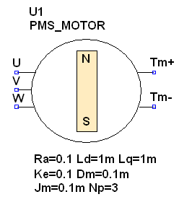
1. Parameter Settings
Symbol
Model Parameters:
RA is the Stator resistance [Ω]
e.g. RA = 0.1, 0.5 or 1[Ω]
LD is the Direct-axis inductance [H]
e.g. LD =1m, 2m or 5m [H]
LQ is the Quadrature-axis inductance [H]
e.g. LQ =1m, 2m or 5m [H]
KE is the Back EMF constant
e.g. KE =0.01, 0.1 or 0.5
JM is the Inertia [kg.m^2]
e.g. JM =0.01m, 0.1m or 0.5m [kg.m^2]
DM is the Friction or Viscous coefficient [Ns/m]
e.g. DM =0.01m, 0.1m or 0.5m [Ns/m]
NP is the Number of pole pairs
e.g. NP=3, 4 or 6
(Default values)

Slide 4
2. Implement of Function (1/2)

Slide 5
2. Implement of Function (2/2)

Slide 6
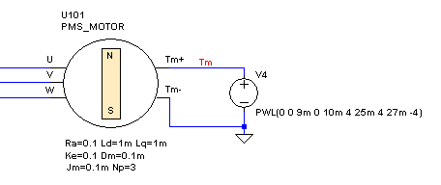
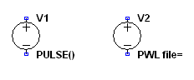
3. How to use Terminal of Tm
3-phase input voltage of PWSM
Tm+ and Tm- connect to VPWL
and so on

Slide 7
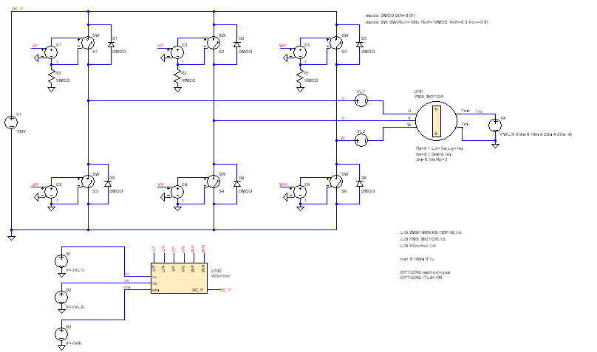
4. Example Vector Control with 2 Current and Speed Sensing
Inverter
PMS Motor
VPWL
Input Current sensing: Iu and Iw
Control and Driver Circuit
Angular velocity: Om

Slide 8
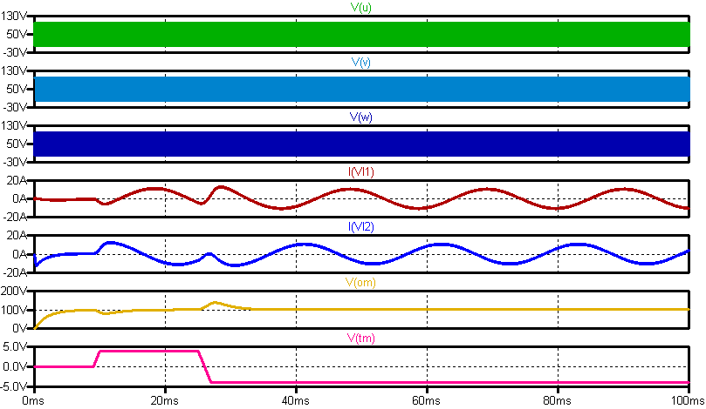
4.2 Simulation Result
(Motor):V_{U}
(Motor):V_{V}
(Motor):V_{W}
(Current Sensing-Motor):I_{u}
(Current Sensing-Motor):I_{w}
(angular velocity-Motor):V_{om}
(torque-Motor):V_{tm}

Slide 9
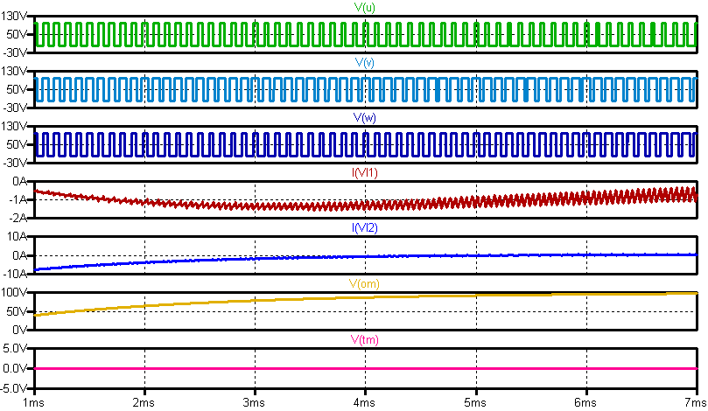
4.2 Simulation Result (Torque: 0) (zoom in)
(Motor):V_{U}
(Motor):V_{V}
(Motor):V_{W}
(Current Sensing-Motor):I_{u}
(Current Sensing-Motor):I_{w}
(angular velocity-Motor):V_{om}
(torque-Motor):V_{tm}

Slide 10
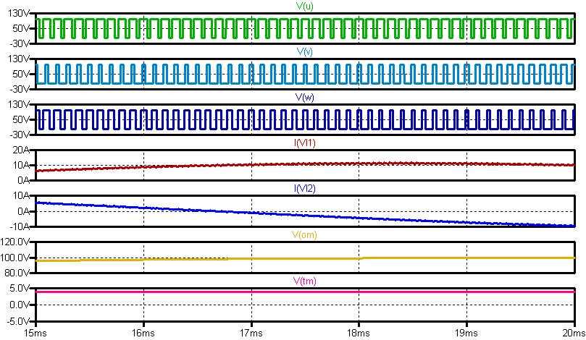
4.2 Simulation Result (Torque: positive) (zoom in)
(Motor):V_{U}
(Motor):V_{V}
(Motor):V_{W}
(Current Sensing-Motor):I_{u}
(Current Sensing-Motor):I_{w}
(angular velocity-Motor):V_{om}
(torque-Motor):V_{tm}

Slide 11
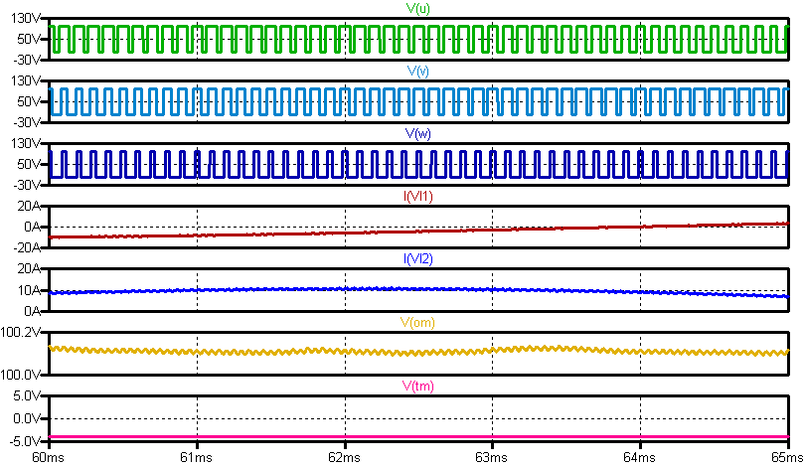
4.2 Simulation Result (Torque: negative) (zoom in)
(Motor):V_{U}
(Motor):V_{V}
(Motor):V_{W}
(Current Sensing-Motor):I_{u}
(Current Sensing-Motor):I_{w}
(angular velocity-Motor):V_{om}
(torque-Motor):V_{tm}

